Slide 1
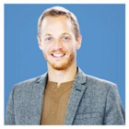

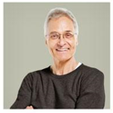


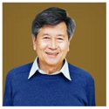
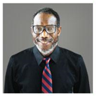

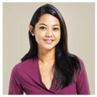

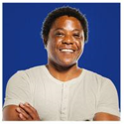
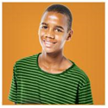


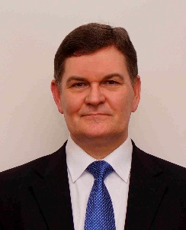
John Smith_0
Caroline Pim_1
Sal Smith_2
Jack Jones_3
Barak Adev_7
Peter Pan_5
John Doe_4
Jackson Bean_10
Ellen Cater_11
Peter Parker_12
Bandi Abbe_6
Hege Pege_13
Donald Evan_14
Eliza Band_8
Garisson Banker_9

Slide 2


